Slide 1
British Airways
Predicting Customer buying behaviour

Slide 2
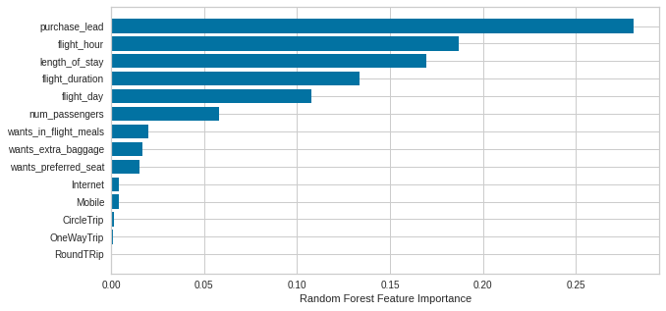
Predictive Model
We used Random Forest Classifier model.
Accuracy Score: 85%
AUC Score: 0.55

